Slide 1

Leave Management System
Submitted under:-
Dr. Mukesh Mann
&
Mr. Sandeep Singh
Submitted by:-
Yugansh Goyal
&
Rohit Raj

Slide 2
INTRODUCTION
The main objective of the system is to computerize the maintenance of the employee details and leave section in the company. It also includes the details about the employee personal.
This approach basically deals with the record of leaves taken by the employees in the organisation

Slide 3
OBJECTIVE OF THE PROJECT
The main objective of the proposed system is to decrease the paper work and easier record maintenance by having a particular website for leaves maintenance.

Slide 4






TOOLS AND TECHNOLOGIES USED

Slide 5
STRUCTURE OF THE PROJECT

Slide 6
Admin
The initial step which is handled by the admin module is to create a unique account for each employee or faculty member in the organization.
This module handles the administrative functions of the system and is used by the head of the department.

Slide 7
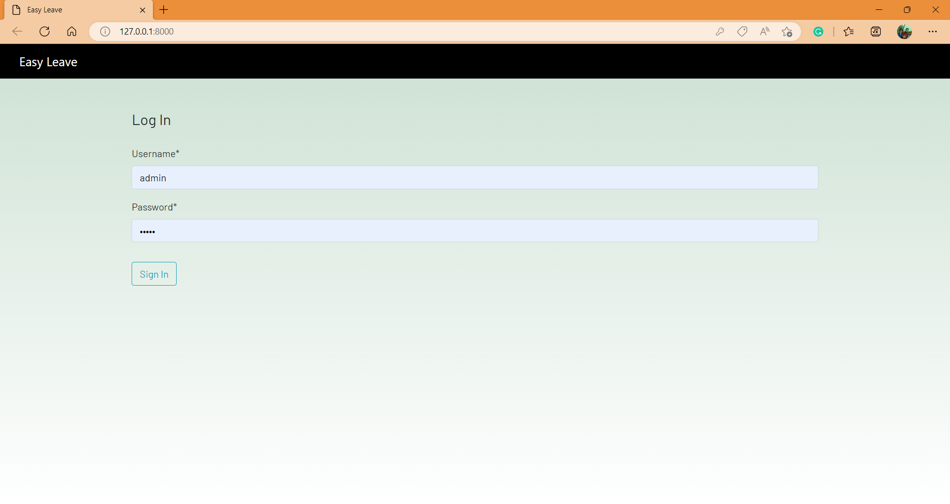
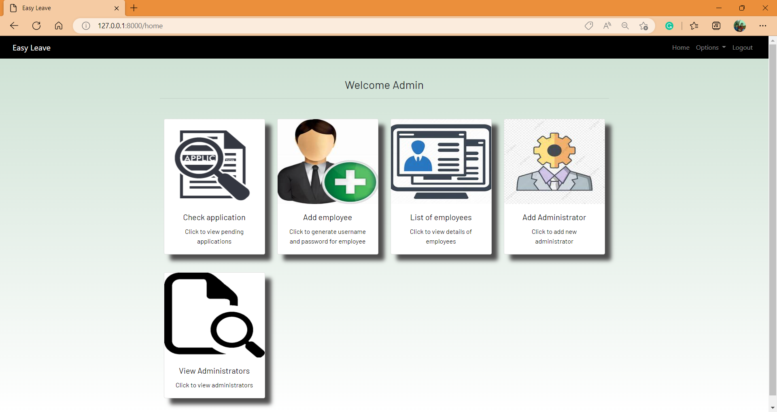
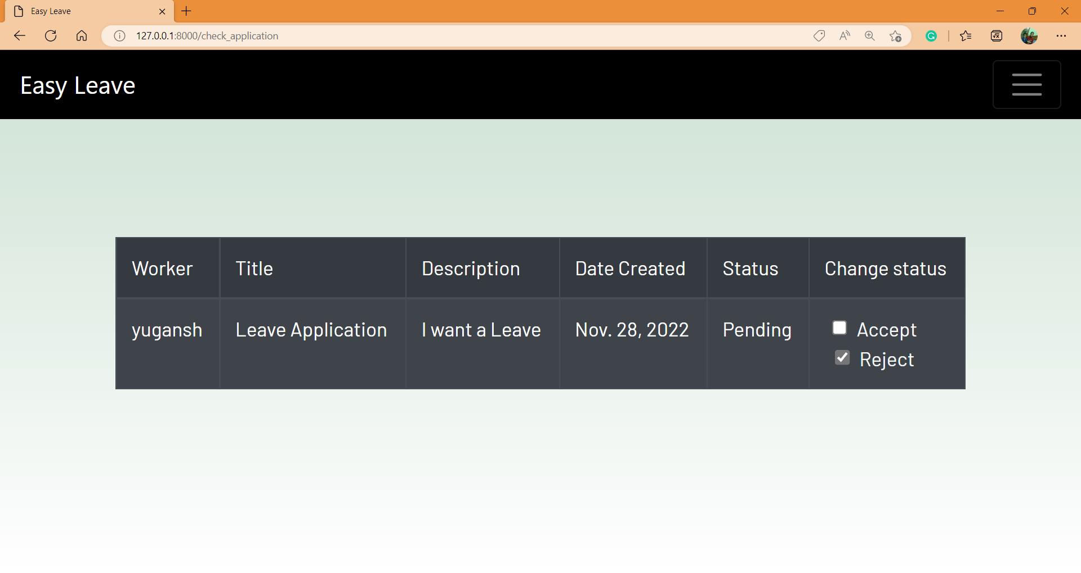
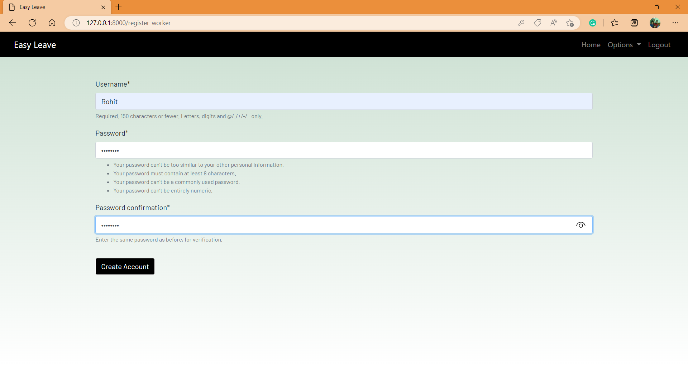
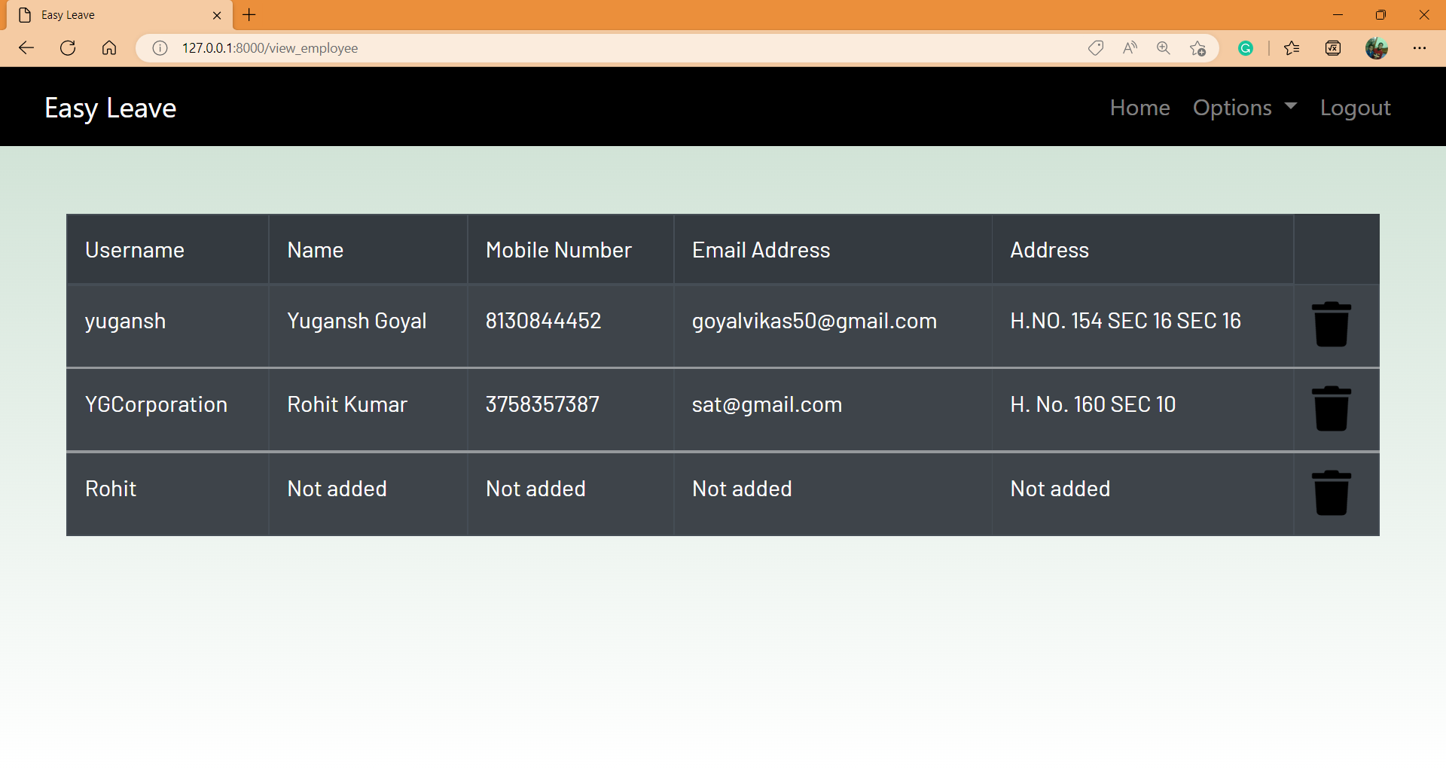
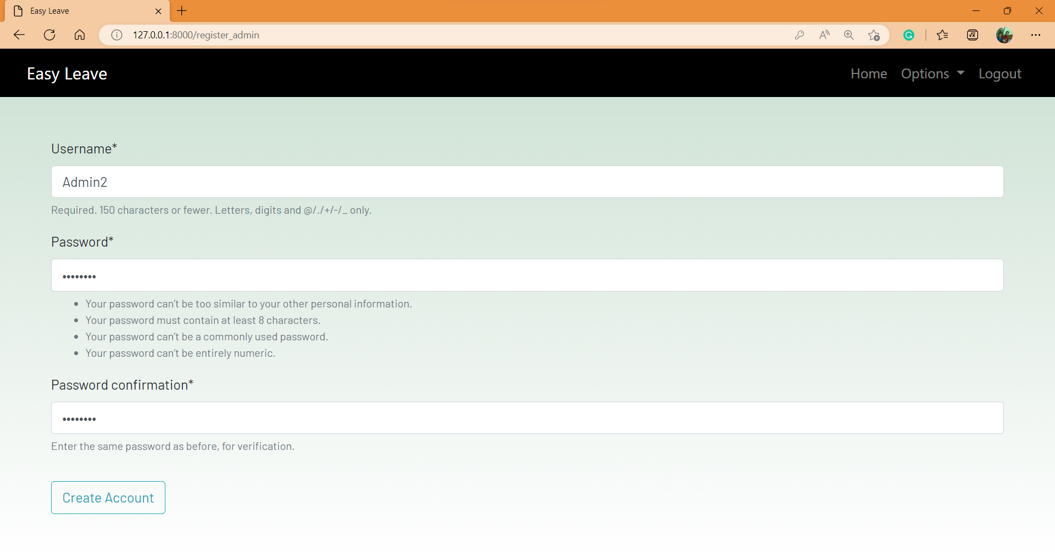
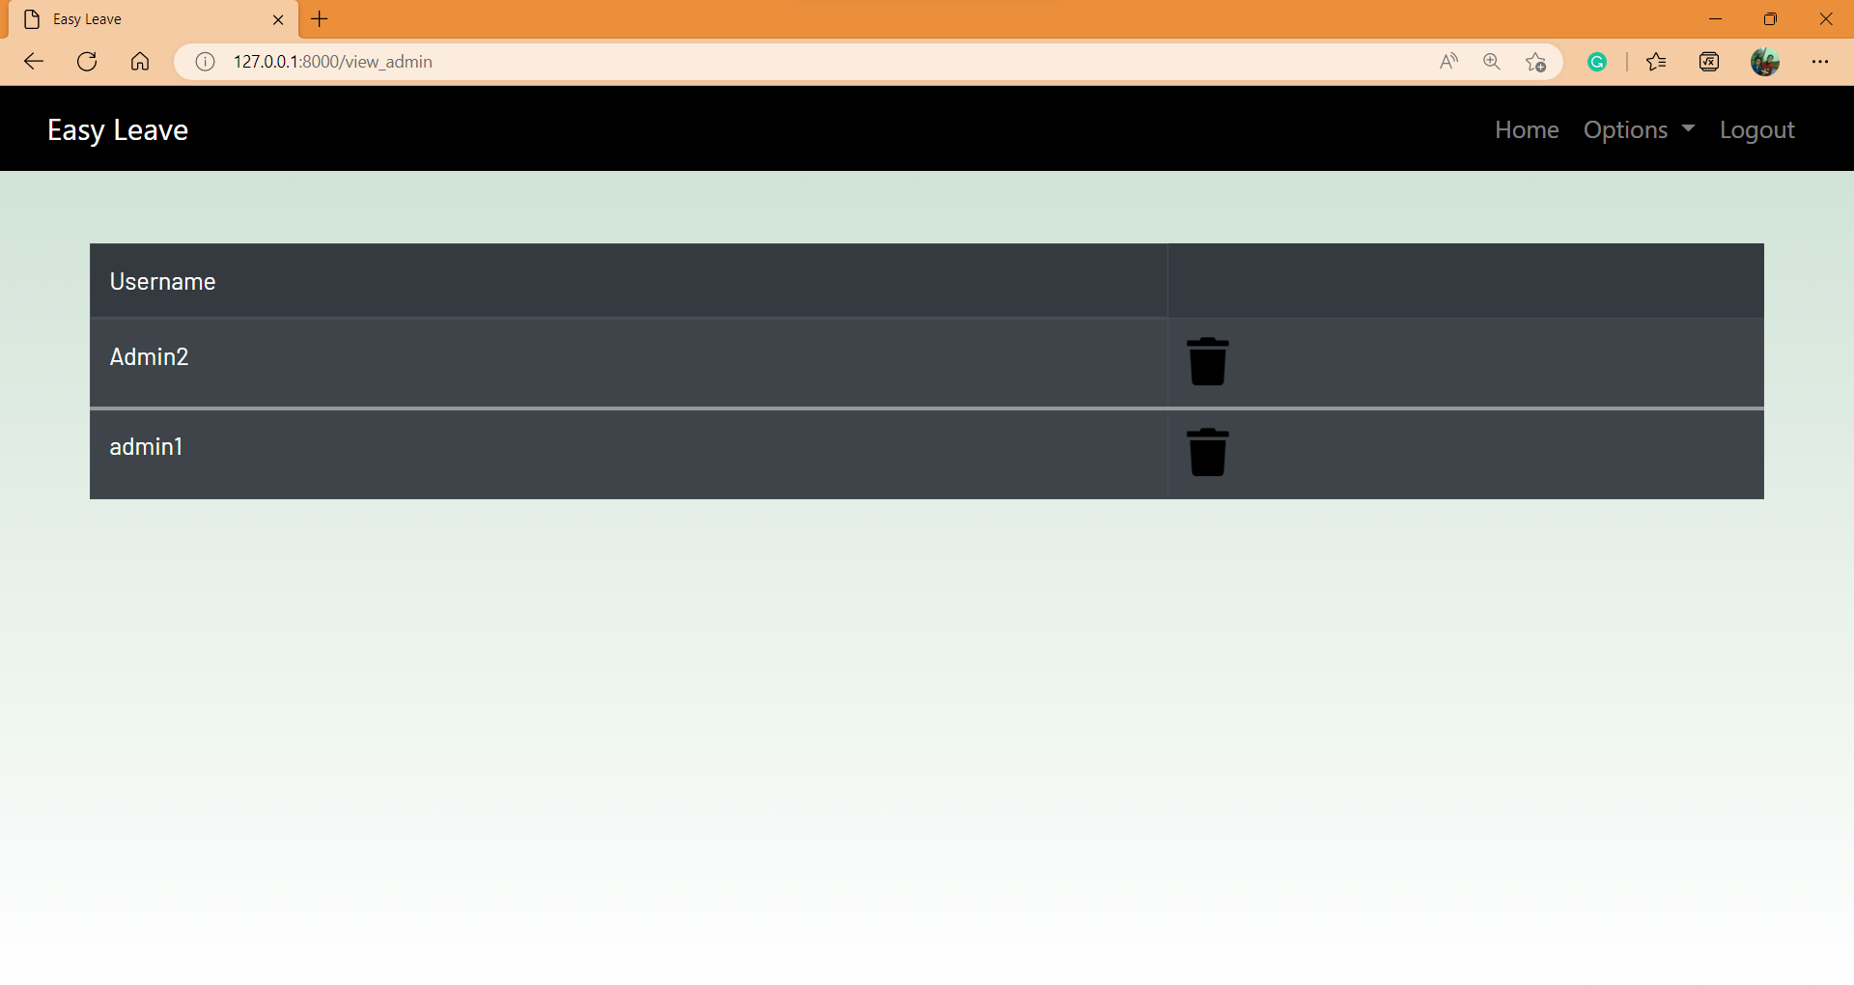

Slide 8
Employee
Employee can log in or log out their account for the leave application with the unique id which is provided by the admin module.
Based on the availability of leave, employee can apply for leave online.

Slide 9
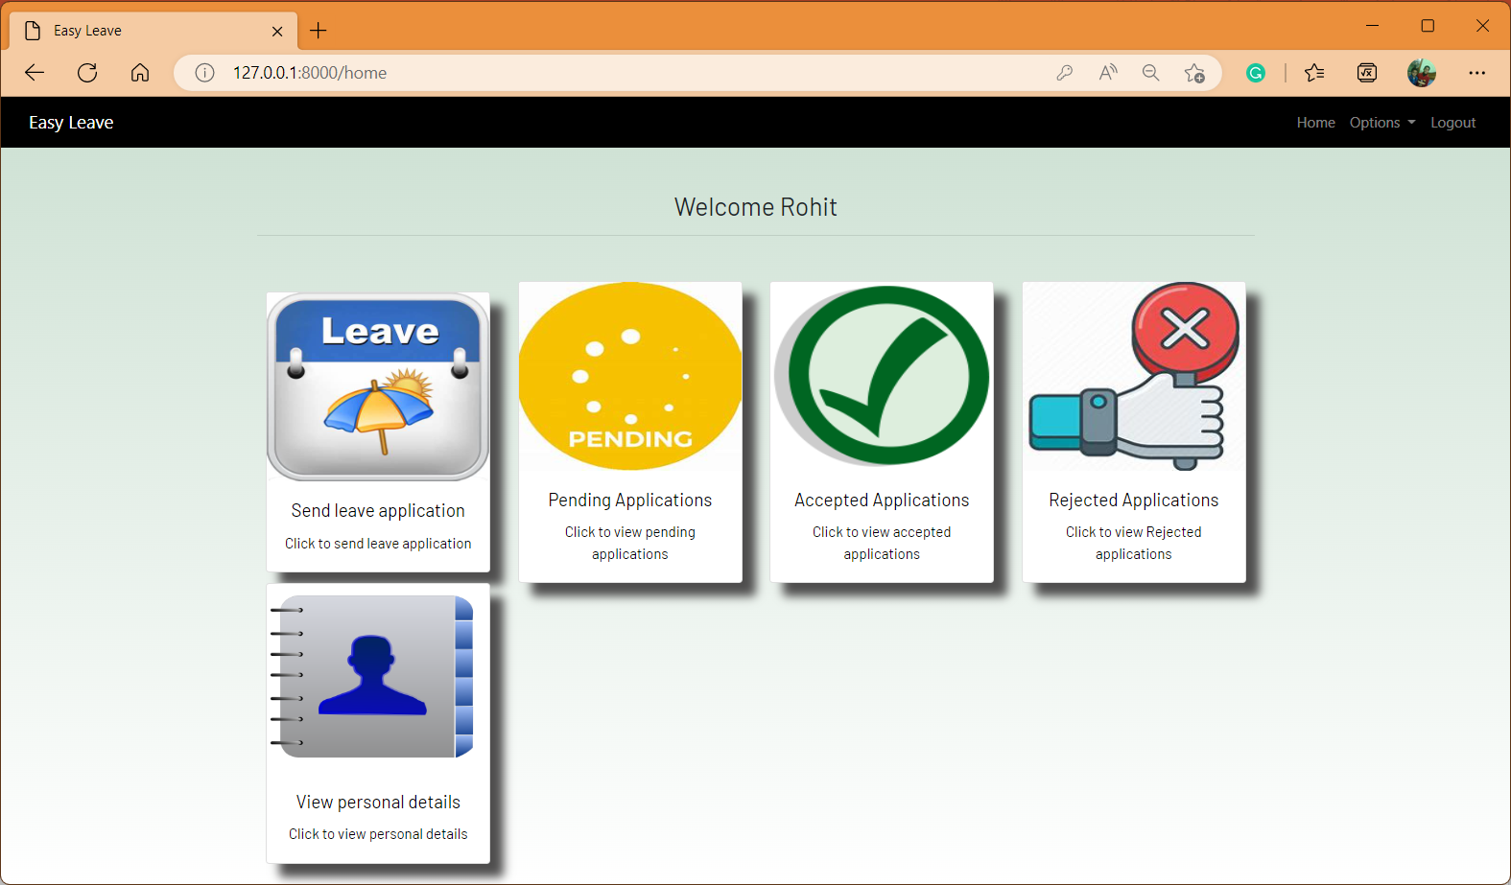

Slide 10
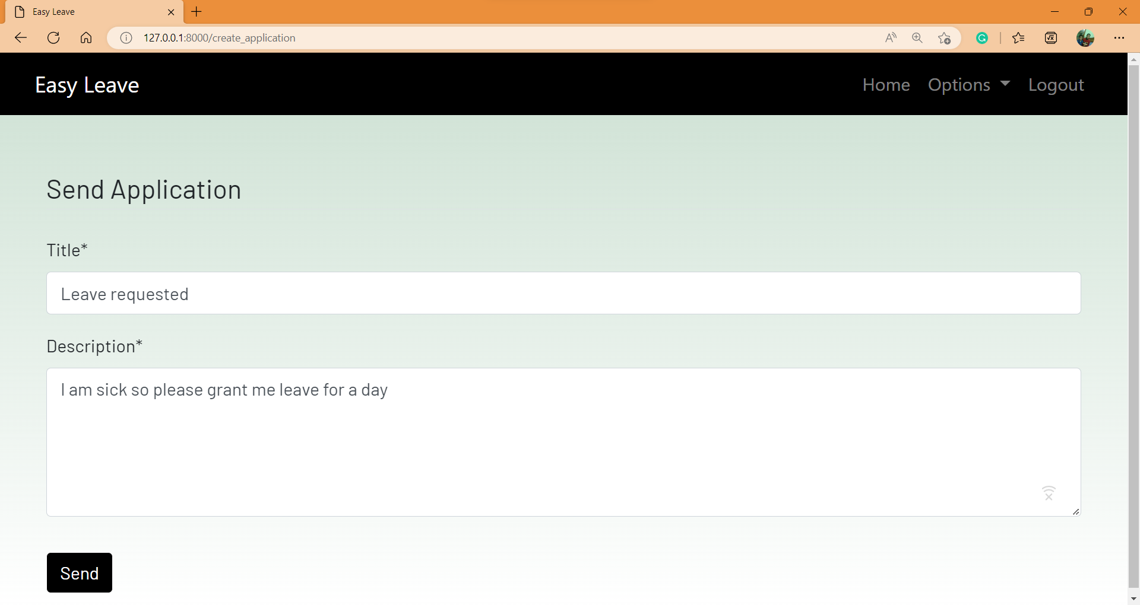
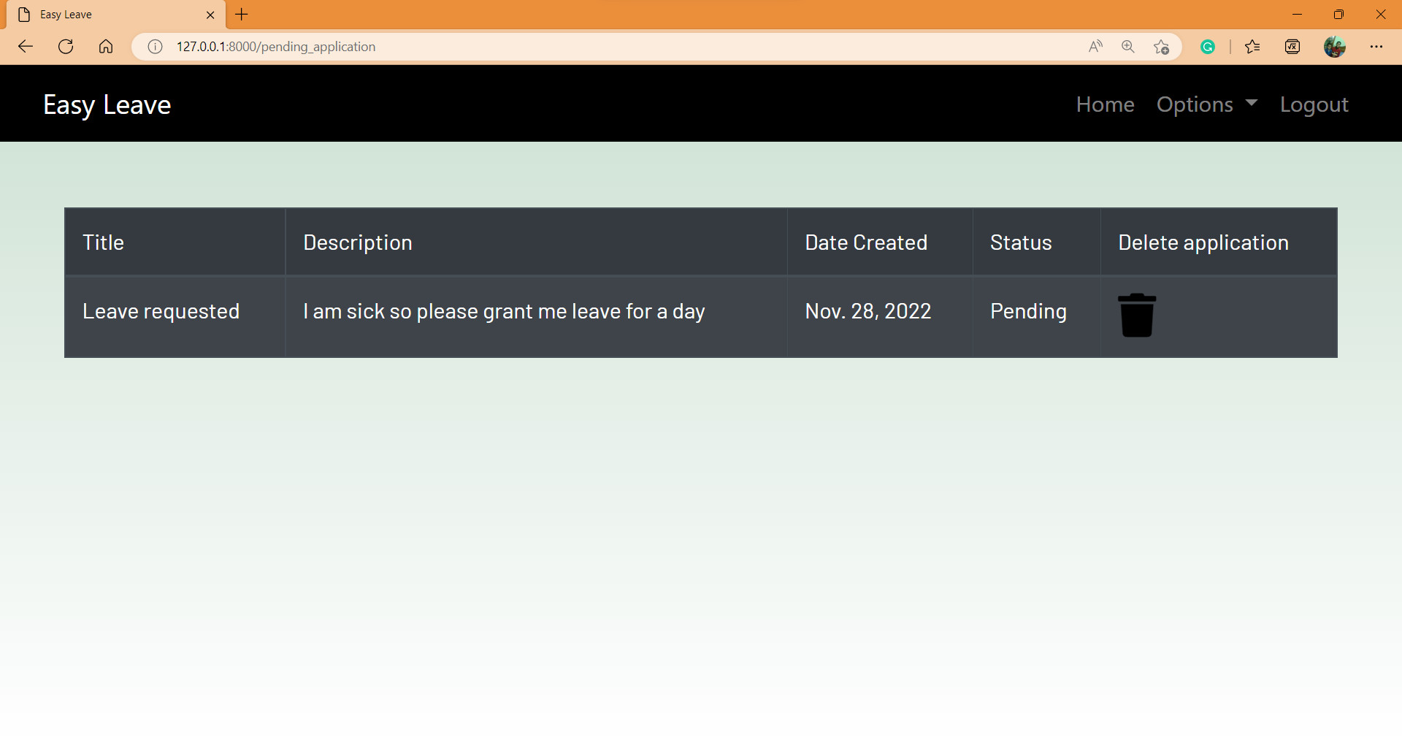
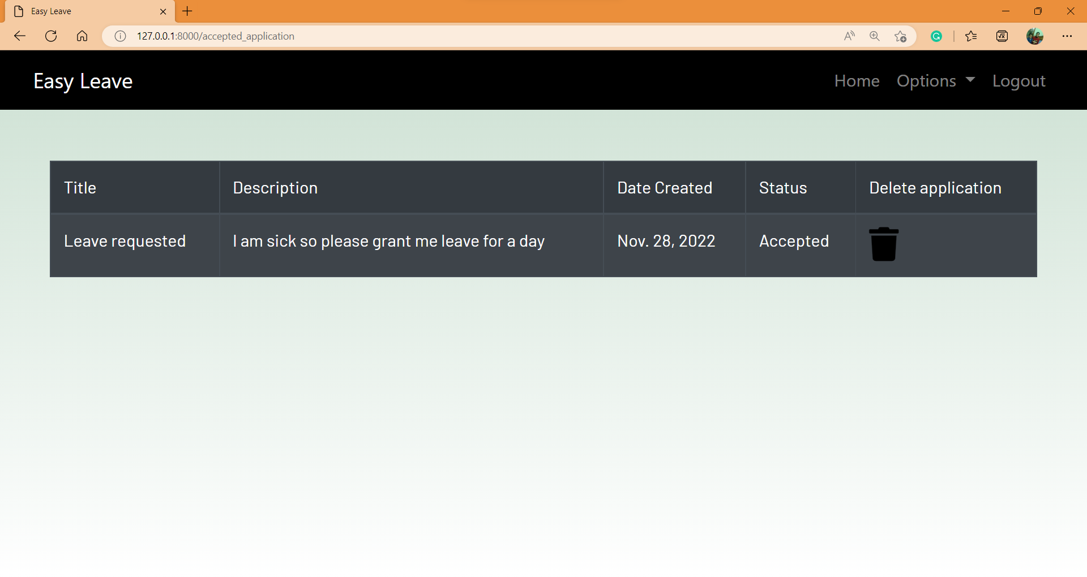
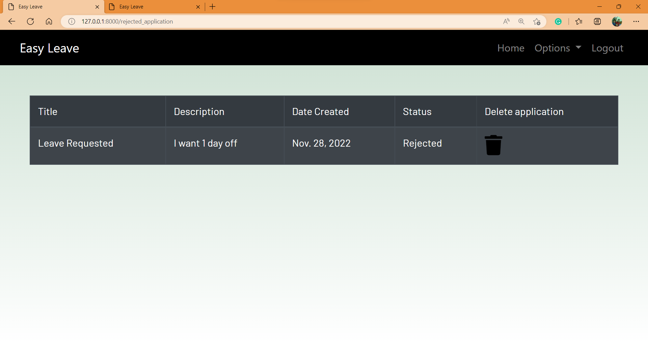
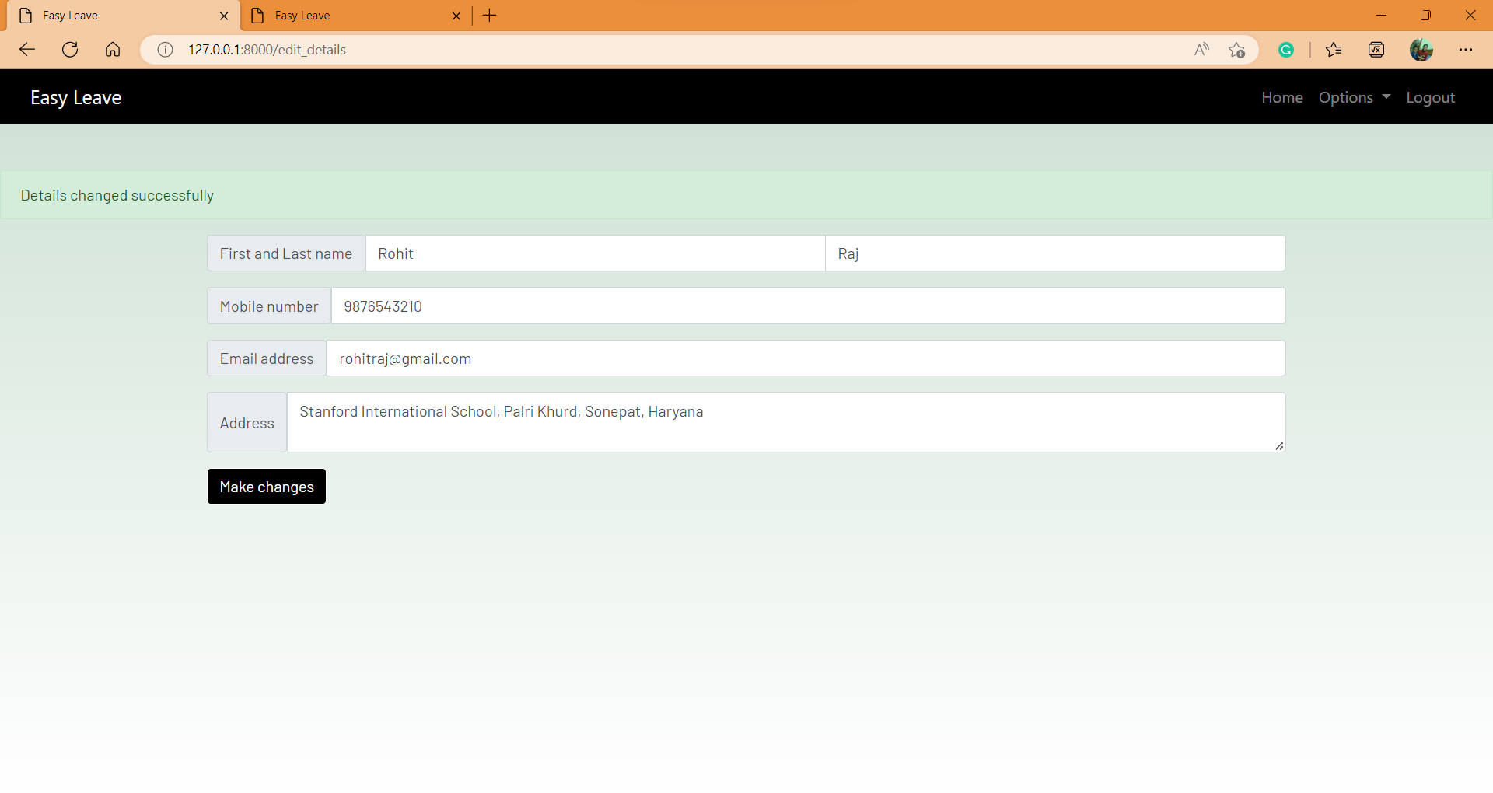

Slide 11
FUTURE SCOPE OF THE PROJECT
This project will enhance the employee and the company to serve more quickly and efficiently. This software is developed in order to computerize the activities which take more time, if done manually.
Leave Management system will enable the employee and company staff to make things faster and can get information quickly. If we want any information about employee, we can access it quickly.

Slide 12
CONCLUSION
Leave Management System is very useful for organizations to maintain the leave records of the employees. This system not only maintains the leaves of the employees, it also maintains the details of the staffs.
The higher may accept or reject the leaves requested by the staff. Thus this system maintains the excess amount of job done by organizations to maintain the leaves.

Slide 13
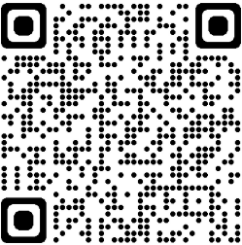
THANK YOU
Website link:-
https://web-production-1e3a.up.railway.app/

